Slide 1
Our Game

Slide 2
Project Overview
A simple yet fun Game
gameplay elements: Timing, Score, Resources(Life Source),
Casual Gaming
Premise to tie Mini games Together
Types: action, puzzle and coordination challenges
Mini Games:
Life Source Game
Clicky Game
Barricade Game

Slide 3
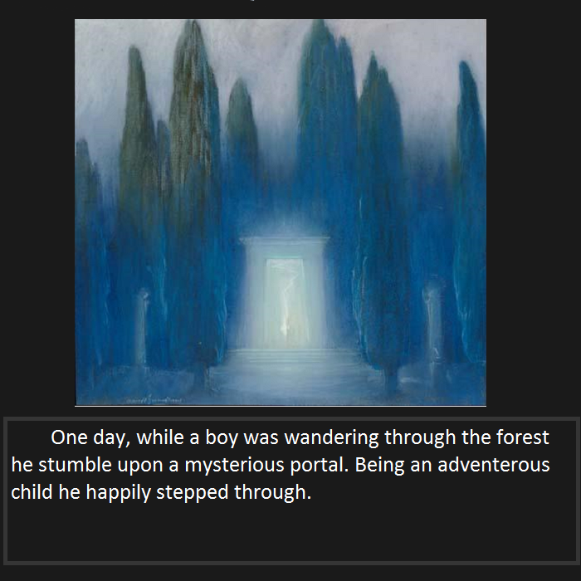

Slide 4
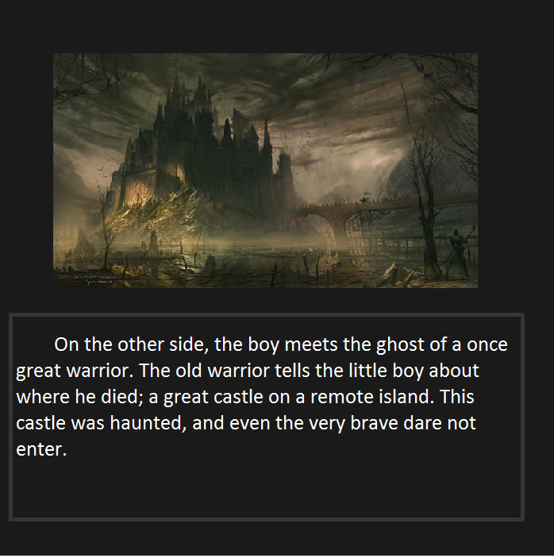

Slide 5
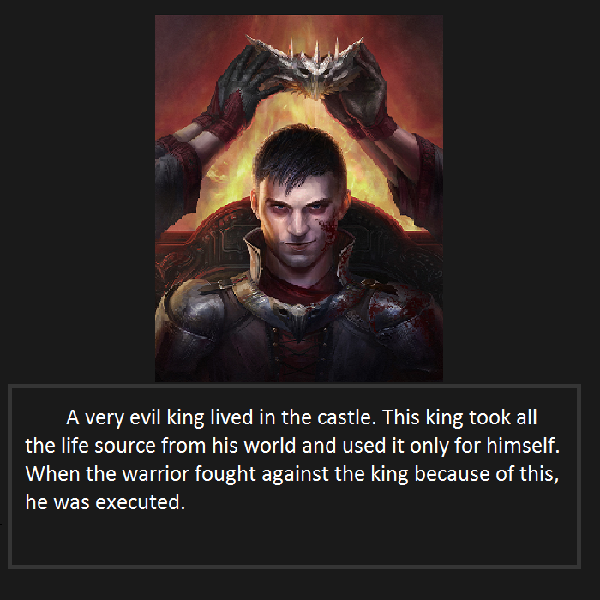

Slide 6
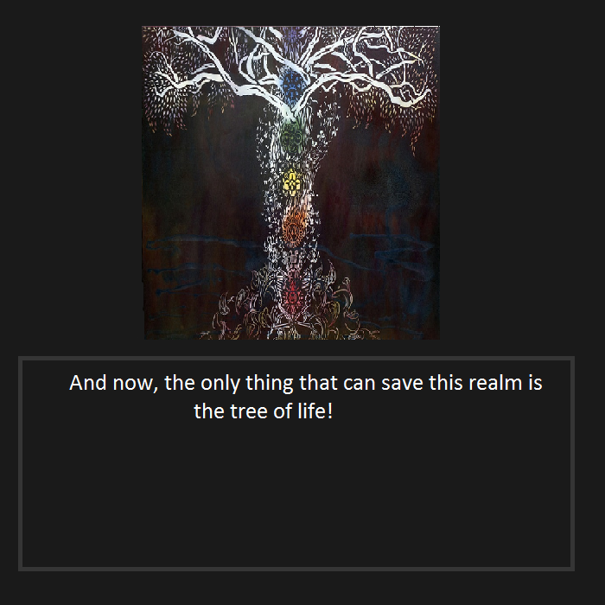

Slide 7
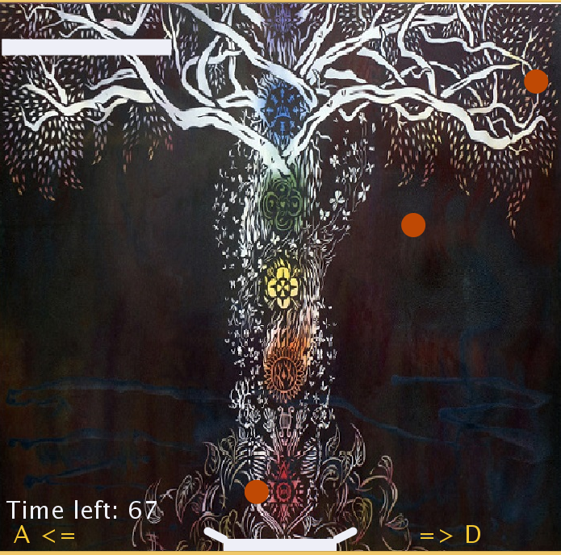
Life source Game

Slide 8
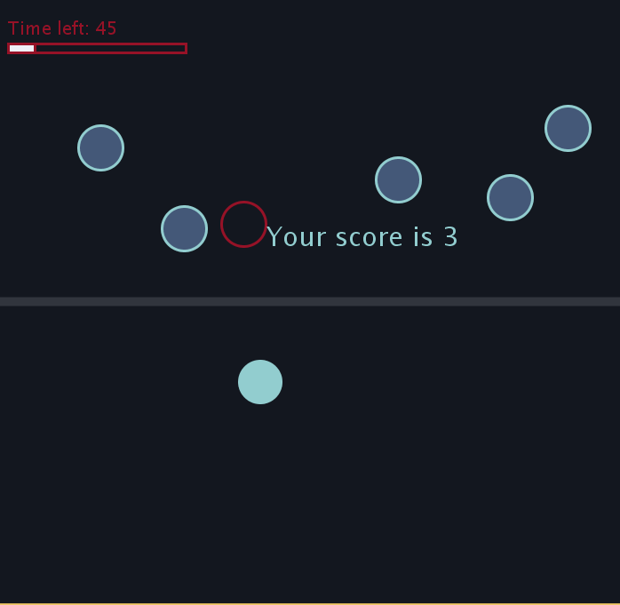
Clicky Game

Slide 9
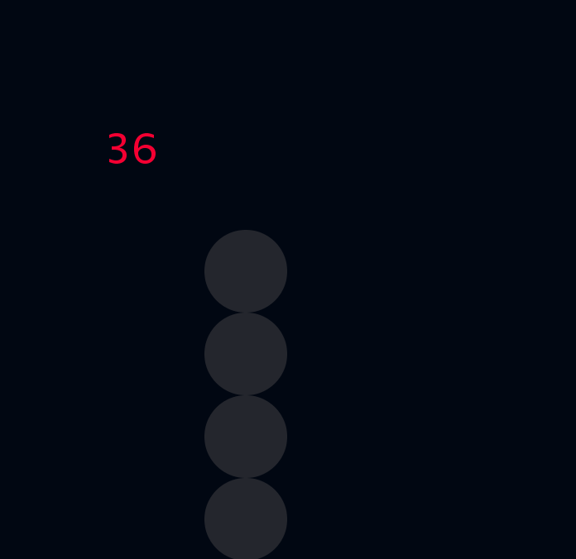
Barricade game

Slide 10
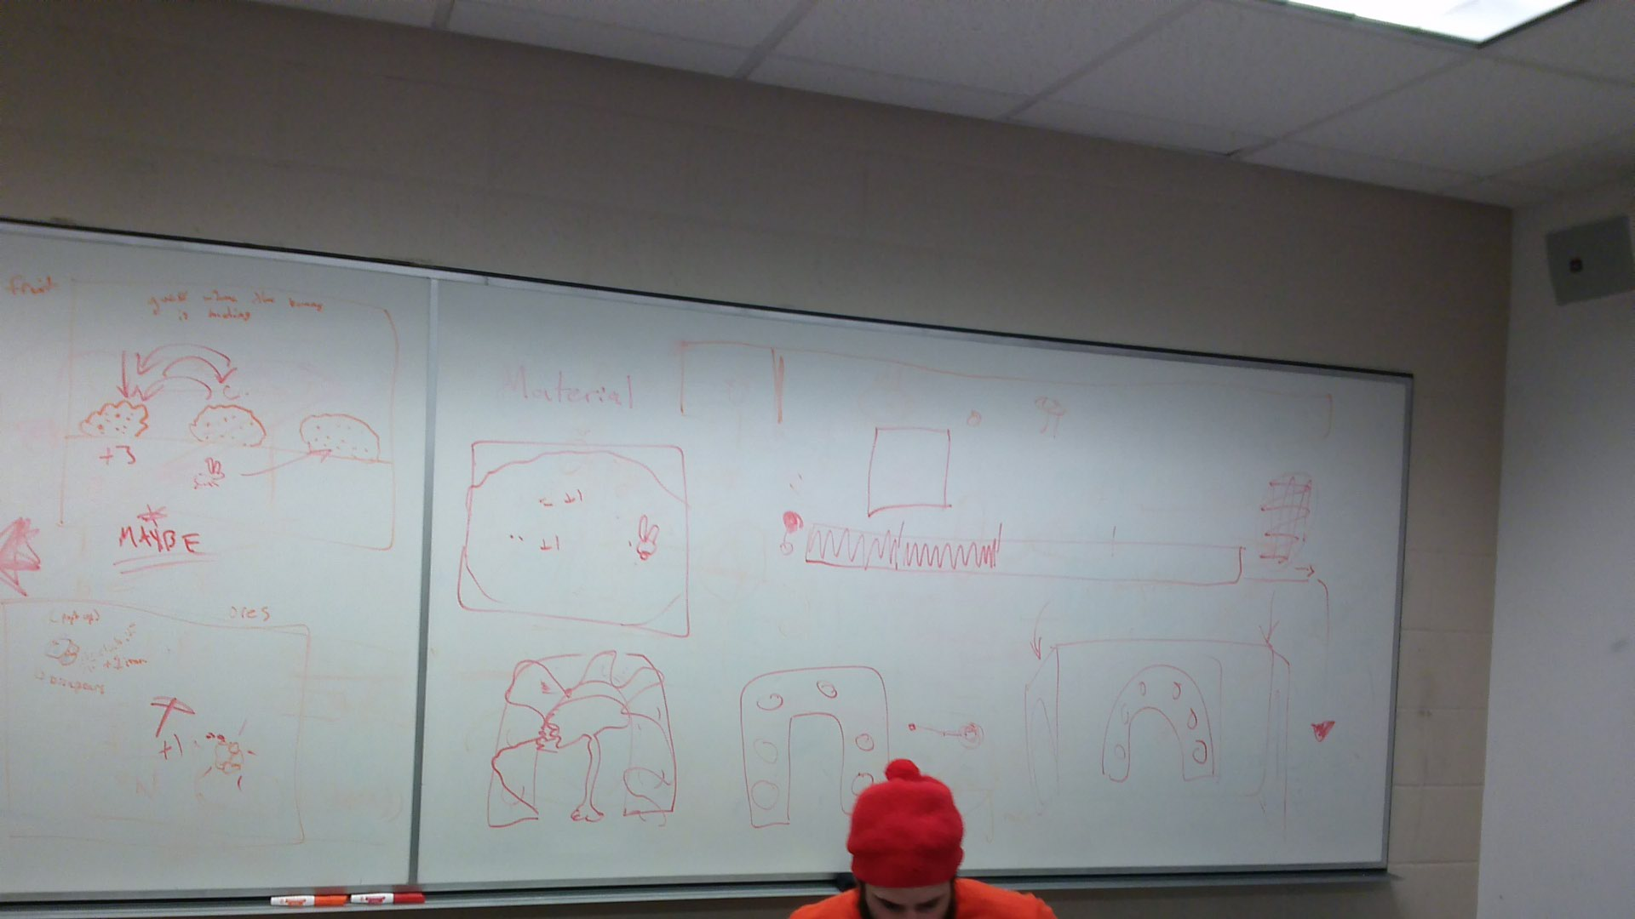
Design Approach: 1st Step

Slide 11
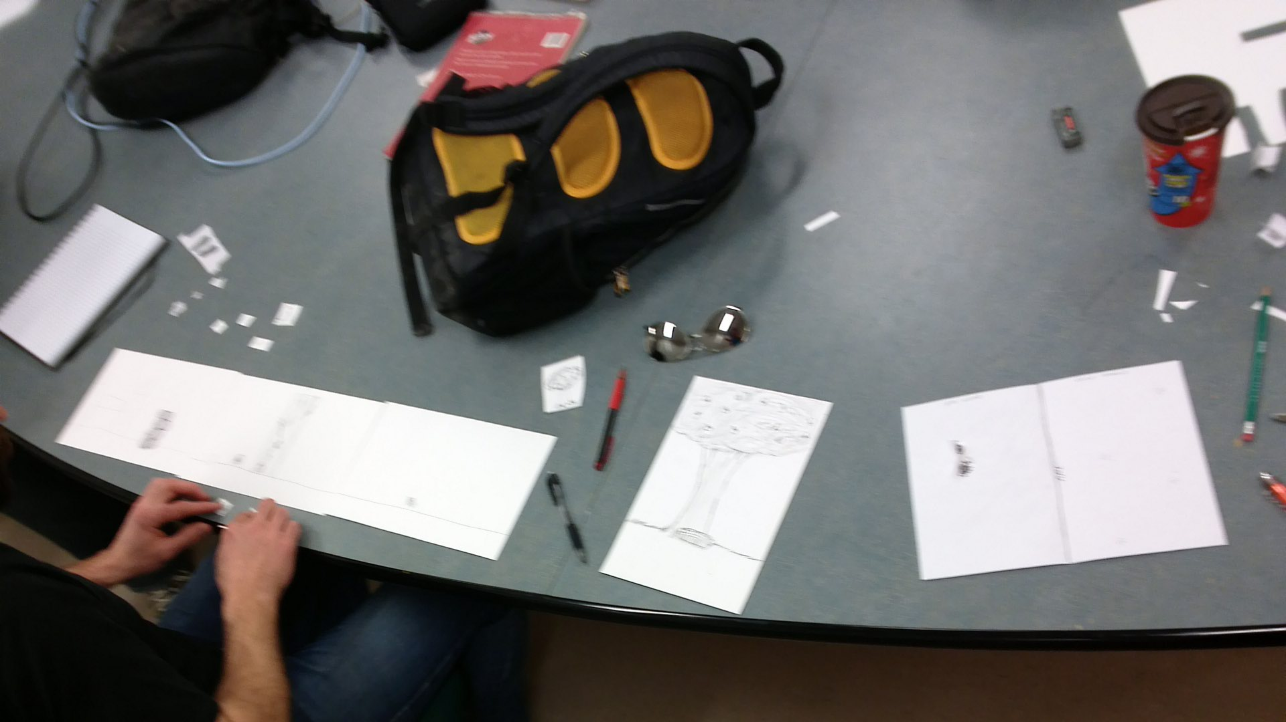
Design Approach: 2nd Step

Slide 12
DEMO
Startup
Life Source Game
Clicky Game
Barricade Game

Slide 13
Process of Testing Digital Prototype: Audience
Friends
Family
Classmates
Process
One-On-One

Slide 14
Process of Testing Digital Prototype: Process
One-On-One

Slide 15
Result
One Main Observation: Hard to understand
Secondary: Very easy Games

Slide 16
Recommendations
Add more Instructions
Add more elements of games to the mini games to make it more game more challenging.

Slide 17
Thank you

